Slide 1

Food expenditure prediction.
J.A. Shehara Anjana-S14426
Gethmini Siriwardena-S14507
M.S. Prathibhani-S14573

Slide 2
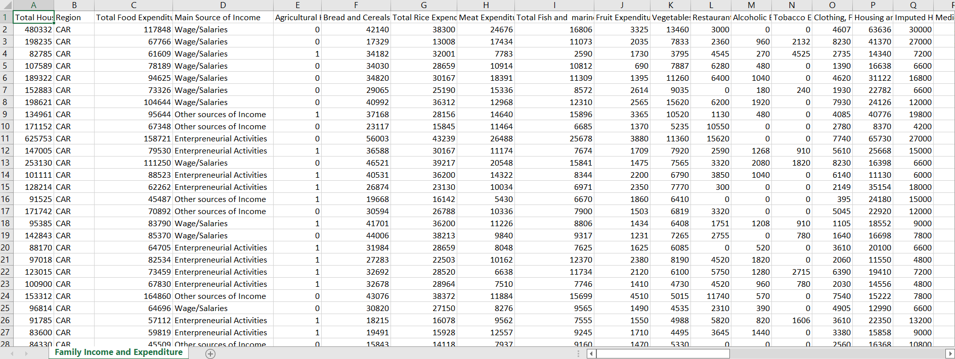
Data Set.

Slide 3




Slide 4
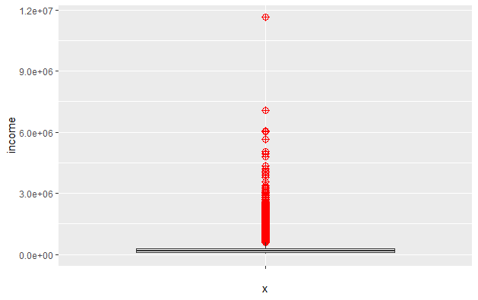
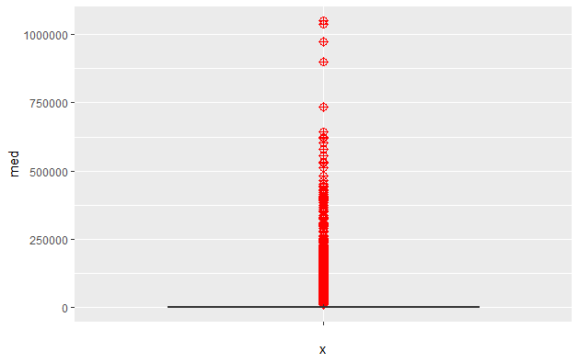


Recap from Descriptive Analysis
Extreme Values in
some variables

Slide 5
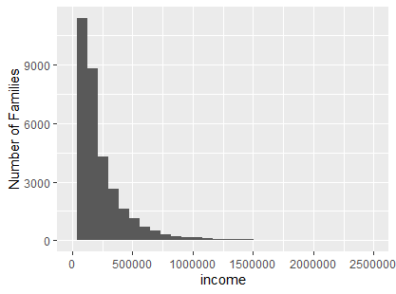

Recap from Descriptive Analysis
A cut-off was decided.
Average
Only 0.631% is eliminated

Slide 6
Re-defined Problem
Predicting the Monthly Food Expenditure of Filipino Families whose income level is less than 1500,000 pesos.

Slide 7
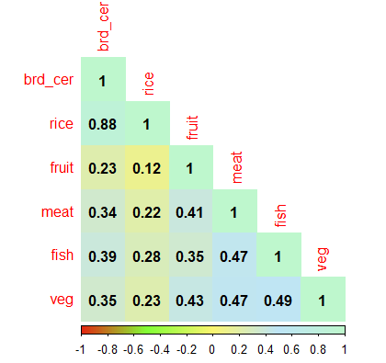
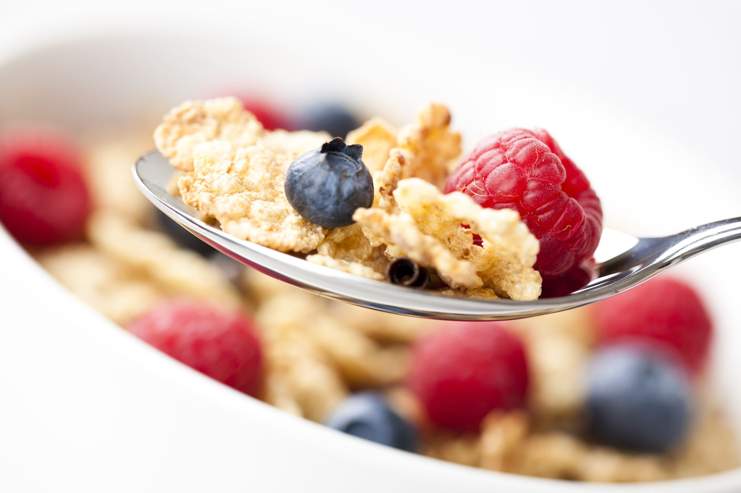


Recap from Descriptive Analysis
This Photo by Unknown Author is licensed under CC BY

Slide 8
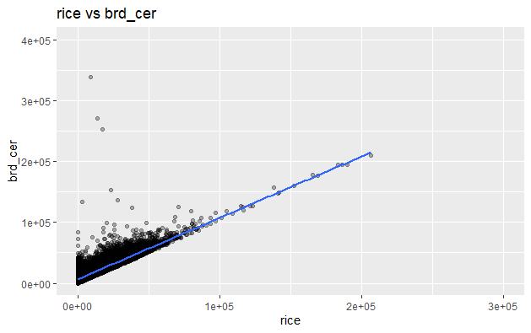
Recap from Descriptive Analysis
This Photo by Unknown Author is licensed under CC BY

Slide 9
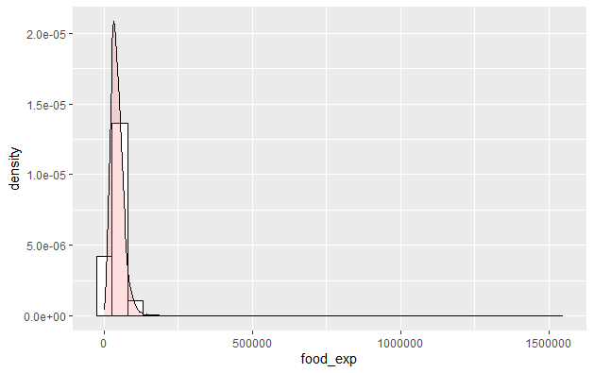
Recap from Descriptive Analysis

Slide 10
Re-Define the Problem.
Predicting the Monthly Bread & Cereal and Rice Expenditure of Filipino Families whose income level is less than 1500,000 pesos.

Slide 11

Predicting Food Expenditure
Using
Income
Medical care expenditure
Region
Total family members
Agricultural Indicator

Slide 12

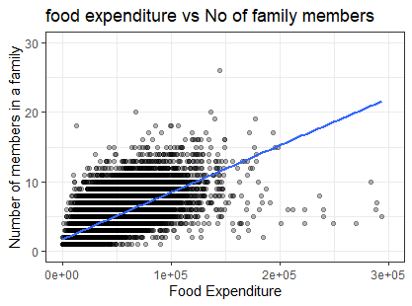
Data Pre-processing..
This Photo by Unknown Author is licensed under CC BY-NC-ND

Slide 13
Data Pre-processing
Food consumptions of Adults, kids, babies are different for each other.
Considering total family members is not fair.

Slide 14



Data Pre-processing

Slide 15



Data pre processing
Derived babies, kids, adults variables from total family members variable using their age categories.

Slide 16


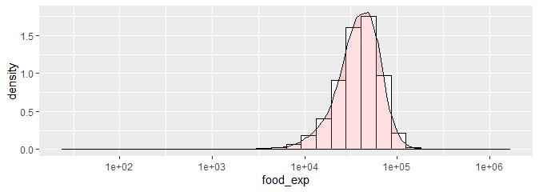
Data Pre-processing

Slide 17


Data Pre-processing
Log transformation

Slide 18
Data Pre-processing
Data set
Observations - 41544
No missing values
No duplicates
Training set
Test set
80%
20%

Slide 19

Up to now….
Checked missing values and duplicates
Set a cut off value for extreme values
Derived suitable predictor variables
Transformed response variable
Split data set into test and train
This Photo by Unknown Author is licensed under CC BY-SA

Slide 20
Regression
Models
Building

Slide 21

Suggestions of descriptive analysis
Linear regression.
Ridge regression
Lasso regression
Elastic net regression
In addition to that,
Partial least square method
Principal component regression

Slide 22
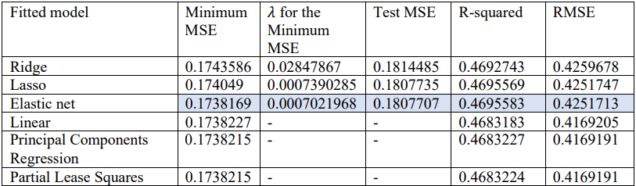

Slide 23
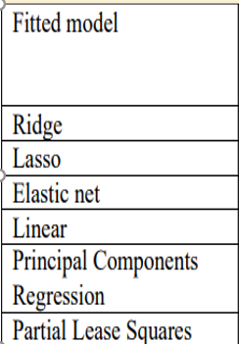
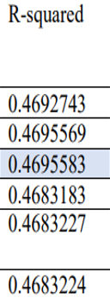

All models have all most same accuracy

Slide 24

Our object is building
Prediction model
With high accuracy.
Elastic net

Slide 25

Further analysis on Elastic net
Test MSE
0.1807707
0.006
Training MSE
0.1738169

Slide 26
Further analysis on Elastic net
Alpha | λ | No of variables
1 | 0.0007021968 | 21/23

Slide 27
Further analysis on Elastic net
All models gives all most same training MSE, R-square

Slide 28
Further analysis on Elastic net

Slide 29
Further analysis on Elastic net

Slide 30
Further analysis on Elastic net

Slide 31
Further analysis on Elastic net

Slide 32
MSE - 0.1738169 R-squared - 0.4695583
Lack of lack of other significant socio-economic variables in this data set.

Slide 33





References.
http://www.sthda.com/english/
http://www.sthda.com/english/wiki/ggplot2-box-plot-quick-start-guide-r-software-and-data-visualization
https://www.ck12.org/book/ck-12-probability-and-statistics-concepts/section/4.6/
https://towardsdatascience.com/
https://www.techtarget.com/searchenterpriseai/definition/machine-learning-ML#:~:text=Machine%20learning%20(ML)%20is%20a,to%20predict%20new%20output%20values.
https://www.kaggle.com/issatingzon/exploratory-data-analysis
https://www.analyticssteps.com/blogs/overview-descriptive-analysis
This Photo by Unknown Author is licensed under CC BY-SA

Slide 34



